Slide 1



Smart vacuum cleaner robot for indoor cleaning
BY
Rishika Singh 1CR24EC172
Tanisha Santhosh 1CR24EC218
Nippuleti Akhila 1CR24EC133
Under the Guidance of Prof.Abinash Panda
Electronics and communications
Notes:
1

Slide 2


1
Introduction
• Automation and robotics are increasingly important in modern technology.
• They help make everyday tasks easier, faster, and more efficient.
• Many activities that once required manual effort can now be automated using smart systems.
• Floor cleaning is a common household task that can benefit from automation.
• Traditional vacuum cleaners require manual operation, which can be time-consuming.
• Smart vacuum cleaner robots can clean floors automatically with minimal human effort.
• This project focuses on designing an Arduino-based smart vacuum cleaner robot.
• The Arduino microcontroller acts as the main control unit for robot movement and the vacuum mechanism.
Electronics and communications

Slide 3
2
Literature Review:
K. Sarath Kumar et.al.,[1] Here, in this project, it is operated using pre-written code placed into an Arduino. When obstacle is encountered, vacuum will turn to the side when there is more space between the car and the obstruction. This uses a lithium battery and an axial fan connected to the motor to collect dust, also utilising a detachable bag can be preferable. An anemometer and pressure gauge is used too.
Humayun Rashid et.al.,[2] In this paper, the implementation of a room cleaning robot has been developed using the Arduino Uno with control ability by cell phone from any distance using DTMF technology. Two smart paths following methods have been utilized by the robot for cleaning operation along with upgraded vacuum system with necessary filter and air suction system.
K.A.M. Annuar et.al.,[3] In this study, an intelligent interface robotic vacuum cleaner is developed. By using HC-06 Bluetooth module, the user can remotely manipulate its movement with Android smartphone. There are two kinds of cleaning modes which are an automatic and manually controlled vacuum cleaning mode.
Electronics and communications

Slide 4
3
Literature Review:
P. Pravin et.al.,[4] This paper proposes a high-pressure automatic vacuum cleaner using Arduino to dry-clean an area automatically. The robot covers the entire room or area by using the border analysis technique. The robot travels in a zigzag path and covers the entire area. It analyses the obstacles by using an ultrasonic sensor and a high-pressure pump to clean.
D. Desmulyati et.al.,[5] This research discusses a vacuum robot that allows it to automatically turn and avoid obstacles, continuing the cleaning process. Additionally, the Bluetooth system can also be manually controlled via a smartphone, allowing it to move forward, backward, turn, and stop. With a DC motor, you can manually operate it by pressing the on/off button located on robot.
Electronics and communications

Slide 5
4
Objective
Many system use the Arduino Uno microcontroller to control motors and perform cleaning operations efficiently. But they require manual help in disposing the trash when storage is full. So we propose a smart vacuum cleaner which can dispose the collected waste without manual help.
Electronics and communications

Slide 6
5
Project Implementation Methodology
Hardware assembly
Circuit Integration
Logic Dev
Testing
Chassis fabrication and integration of the vacuum suction chamber using a high-RPM DC axial fan.
Wiring the Arduino with the Motor Shield and calibrating power distribution across components.
Development of the 'Scan & Turn' algorithm for seamless indoor navigation and obstacle mapping.
Stress-testing suction efficiency and autonomous hatch logic for waste disposal.
Electronics and communications

Slide 7
6
Components:
Wheels[4]
Plastic lid etc[for base]
Plastic bottle[container]
Fan
Pipe/inlet
Gear motors[4]
Motor[1]
Arduino uno
Arduino motor shield
Servo motor[sg90]
Ultra sonic sensor[HC-SR04]
Lithium battery[2, 1.5V]
Electronics and communications

Slide 8
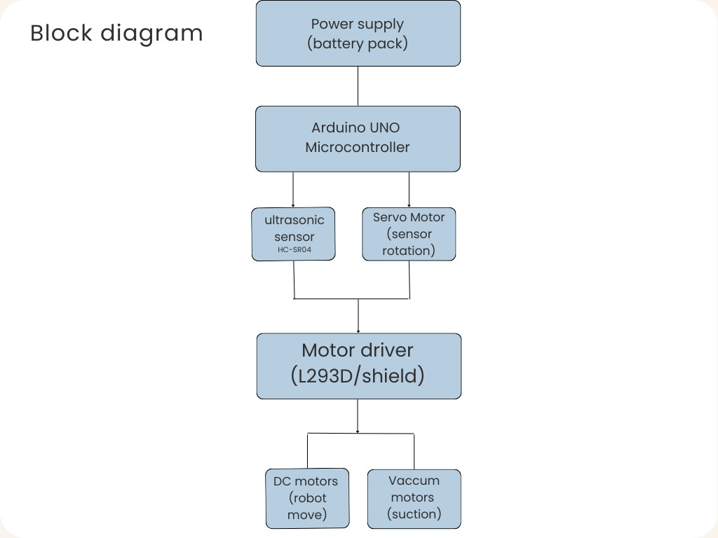
7
Electronics and communications

Slide 9
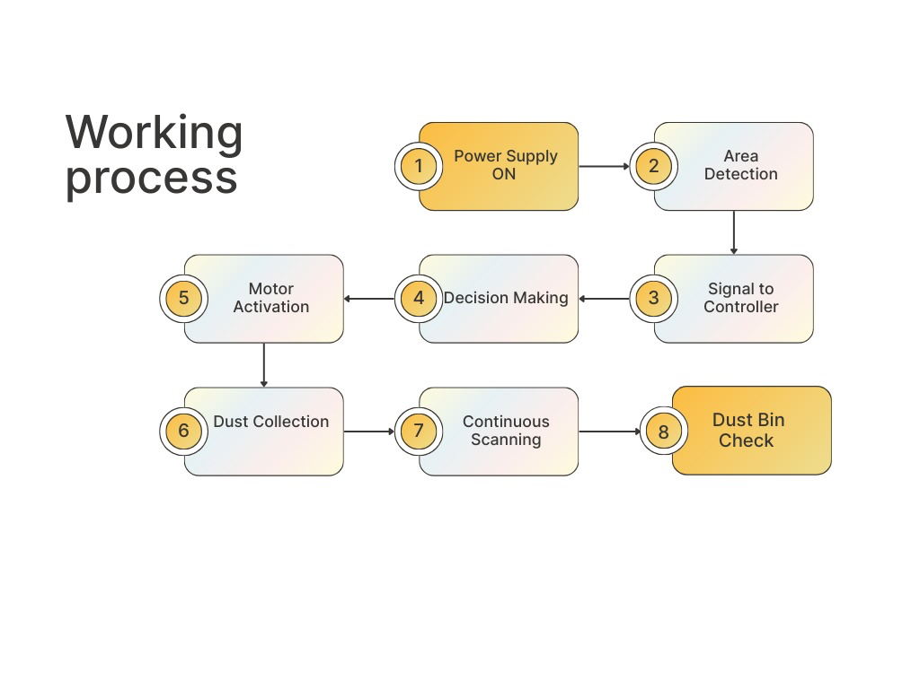
8
Electronics and communications

Slide 10
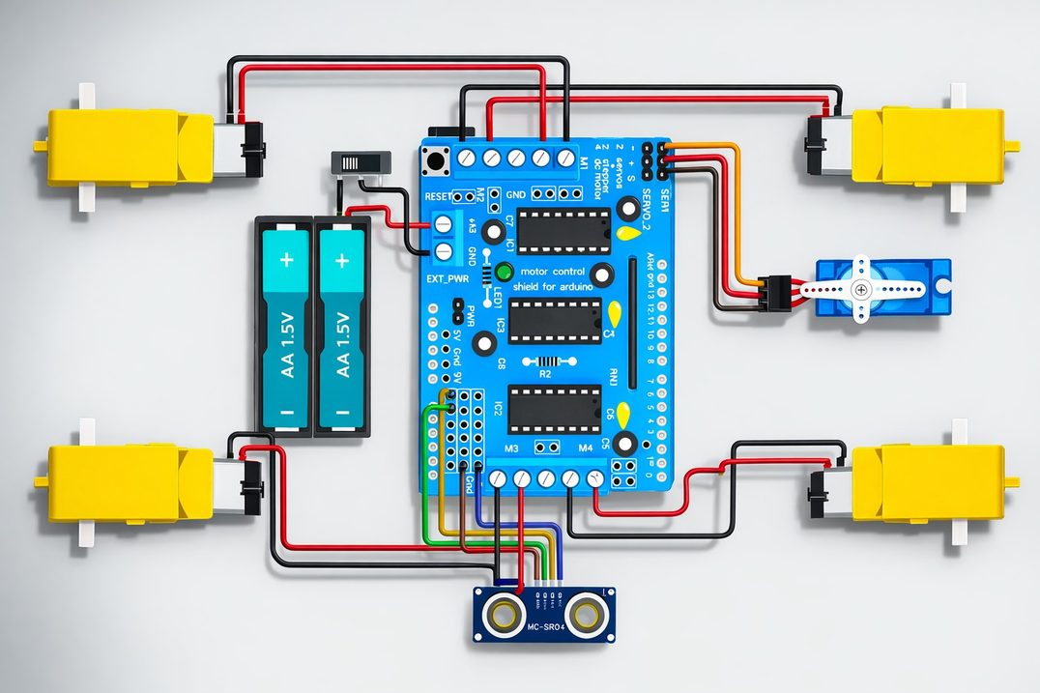
9
Circuitry:
Electronics and communications

Slide 11
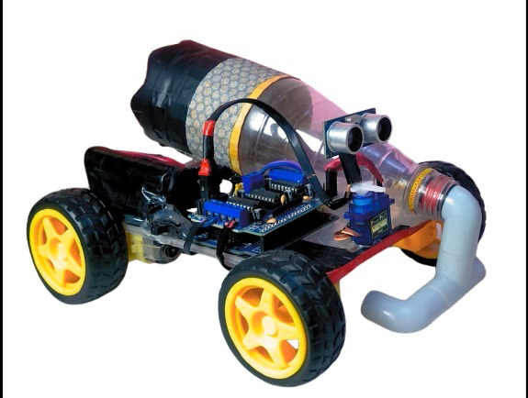
10
Prototype:
Electronics and communications

Slide 12
11
Conclusion
The smart vacuum cleaner we propose is designed to go beyond conventional cleaning devices by integrating obstacle avoidance with autonomous waste disposal. This dual functionality ensures efficient navigation in complex environments and minimizes human intervention. Ultimately, the project highlights the potential of combining IoT and robotics to create sustainable, user‑friendly solutions for modern living.
Electronics and communications

Slide 13
11
Reference
[1] K. Sarath Kumar, M. Pavan, N. Kishore Karthikeya, P. Sai Venkata Lokesh, K. Sasidhar, T. Harith “Arduino Based Smart Vacuum Cleaner” International Journal for Research in Applied Science & Engineering Technology (IJRASET), volume: 2 issue: 3, pp: 416-423, March 2023.
[2] Humayun Rashid, Akash Mahmood, Sarjahan Shekha, S M Taslim Reza, Md. Rasheduzzaman “Design and Development of a DTMF Controlled Room Cleaner Robot with Two Path Following Method” 9th International Conference on Computer and Information Technology (ICCIT), pp: 147-152, December 2016.
[3] K.A.M. Annuar, R.M. Dahari, M.H. Harun, M.R.M. Sapiee and N.A. Ab Hadi “Design and Implementation of Vacuum cleaner Robot Using Arduino and Smartphone” ARPN Journal of Engineering and Applied Sciences, Volume: 13 Issue: 14, pp. 5692-5698, July 2018.
[4] P. Pravin, G. Babin Dhas, T. Tijo and M. John Bosco “High-pressure automatic vacuum cleaner using Arduino” BOHR Journal of Electrical & Electronic Communication Engineering, volume: 1 issue: 1, pp. 18–20, January 2024.”
[5] D. Desmulyati, H. Saiyar, M. H. Siregar, and M. Noviansyah, "Vacuum Cleaner Robot with Arduino R3 Android Based," Golden Ratio of Data in Summary, vol. 4, no. 2, pp. 958-968, 2024
Electronics and communications

